Slide 1

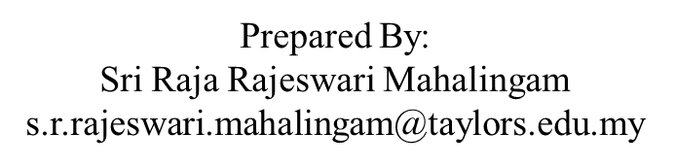
APPLICATION CHEMISTRY A2 LEVEL
ANALYTICAL CHEMISTRY CHAPTER 4:
SOLVENT EXTRACTION

Slide 2
Successive extractions
Solvents are often expensive and flammable, and can also be polluting to the environment.
Use the minimum amount of solvent that is needed to achieve the intended goal.
But, if the solvent is a volatile one, and if the solute is involatile and stable to heat, it is possible to ‘automate’ the process by using a continuous extraction apparatus.
Solvent extraction is used to
extract perfumes and pharmaceutical precursors from plants
in the analysis of insecticide residues and other pollutants in drinking water supplies, blood and milk.

Slide 3
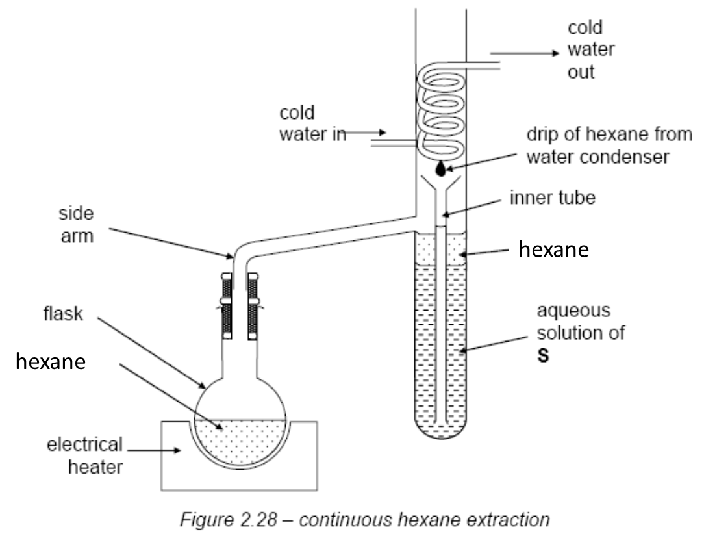
Successive extractions

Slide 4
Example
When 100cm³ of an aqueous solution containing 2.0g of the organic dye X was shaken with 20cm³ of hexane, it was found that 1.60g of the dye had been extracted into the hexane.
[Partition coefficient is 20.]
We can extract more than this if two separate 10cm³ portions of hexane, rather than one 20 cm³ portion.

Slide 5
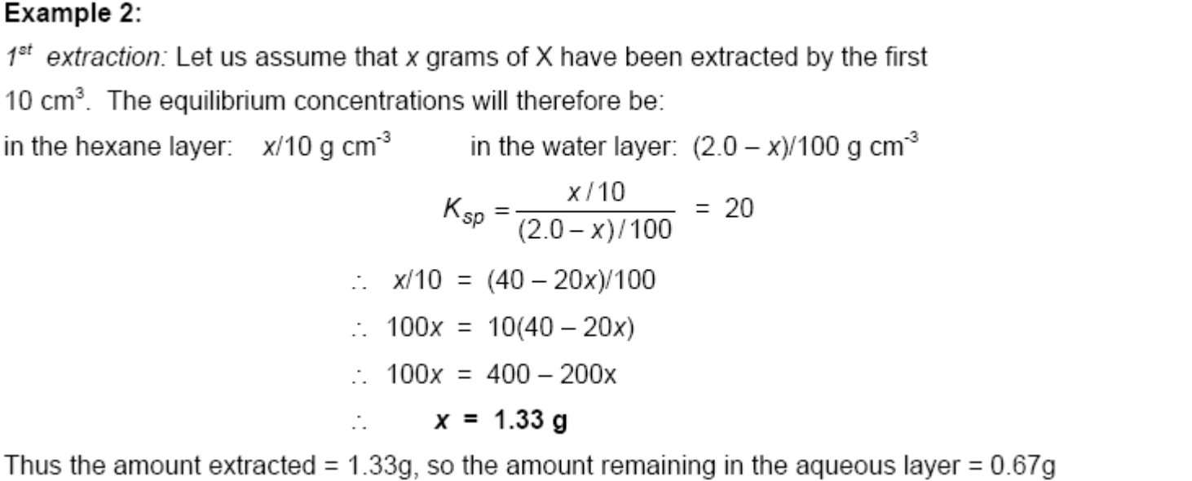
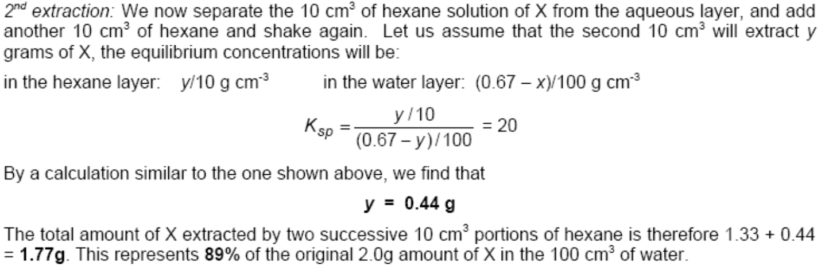

Slide 6
Successive extractions
The use of 20 cm³ of hexane allowed 1.6g of the dye X to be extracted from its aqueous solution, i.e. (1.6/2.0) x 100 = 80%.
We can extract more than this if we use two separate 10 cm³ portions of hexane = 89%
If we had split the 20 cm³ of hexane into four 5 cm³ portions, the amounts of X extracted at each stage would have been as follows:
1st extraction by 5 cm³ : 1.00g
2nd extraction by 5 cm³ : 0.50g
3rd extraction by 5 cm³ : 0.25g
4th extraction by 5 cm³ : 0.125g
total extracted = 1.875 g (94%)

Slide 7
Successive extractions
All these results are collected together in the following table:
However, it is impossible to extract all of a solute, no matter how many portions of solvent we use.
It is never possible to move any equilibrium completely to one side or the other.

